Slide 1

CUSTOMER LOAN PREDICTION ANALYSIS
Presented by :
G.SAI TEJA 20R01A67D5
G.BHANU 21R05A6717
M.KARTHIK 21R05A6713
K.SANDEEP 20R01A67F2

Slide 2
INDEX
ABSTRACT
INTRODUCTION
EXISTING SYSTEM
DISADVANTAGES
PROPOSED SYSTEM
ADVANTAGES
ALGORITHMS
SYSTEM REQURIEMENTS
CONCLUSION

Slide 3
ABSTRACT
The customer loan prediction analysis is an important task in the financial sector to assess the creditworthiness of potential borrowers.
In this analysis, various factors such as credit history, income, employment status, and other personal and financial information are used to predict the likelihood of loan repayment.
The main goal is to minimize the risk of default by identifying potential high-risk borrowers and approving loans for low-risk borrowers. This analysis can help financial institutions make informed decisions and improve their loan approval process.

Slide 4
INTRODUCTION
Distribution of the loans is the core business part of almost every banks. The main portion the bank's assets is directly came from the profit earned from the loans distributed by the banks.
The prime objective in banking environment is to invest their assets in safe hands .Today many banks/financial companies approves loan after a regress process of verification and validation but still there is no surety whether the chosen applicant is the deserving right applicant out of all applicants .
Through this system we can predict whether that particular applicant is safe or not and the whole process of validation of features is automated by machine learning technique

Slide 5
PROBLEM STATEMENT
The problem of loan default is a major concern for lending institutions as it can result in significant financial losses and damage to their reputation.
Therefore, it is crucial to develop accurate predictive models that can assess the creditworthiness of borrowers and minimize the risk of loan default. This requires analyzing large amounts of historical loan data and identifying the key factors that affect loan repayment.
In this presentation, we will address the problem of loan default and demonstrate how machine learning techniques can be used to predict customer loan repayment behavior.

Slide 6
EXISTING SYSTEM
Machine Learning implementation is a very complex part in terms of Data analytics.
Working on the data which deals with prediction and making the code to predicit the future of
out comes from the customer is challenging part.

Slide 7
DISADVANTAGES
Complexity in analyzing the data.
Prediction is challenging task working in the model
Coding is complex maintaining multiple methods.
Libraries support was not that much familiar.

Slide 8
PROPOSED SYSTEM:
Python has a is a good area for data analytical which helps us in analyzing the data with better models in data science.
The libraries in python makes the predication for loan data and results with multiple terms considering all properties of the customer in terms of predicting.

Slide 9
ADVANTAGES
Libraries helps to analyse the data.
Statistical and prediction is very easy comparing to existing
technologies.
Results will be accurate compared to other methodologies.

Slide 10
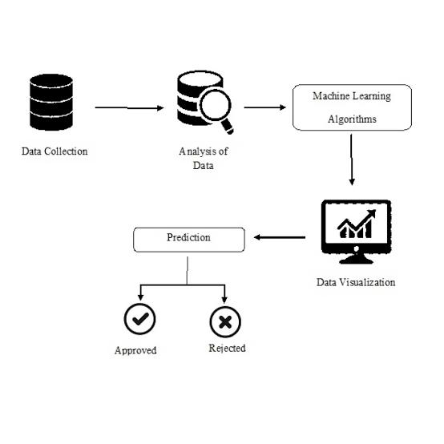

Slide 11
Algorithms
Logistic regression
Logistic Regression is a popular classification algorithm used in predicting the probability of an event occurring.
In customer loan prediction analysis, it is used to predict whether a customer will default on their loan or not.
The algorithm analyzes several variables, such as the customer's income, credit score, and loan amount,
to predict the likelihood of default.
Logistic Regression is a simple yet powerful algorithm that works well with binary classification problems.

Slide 12
Decision Trees
Decision Trees are a popular algorithm used in both classification and regression tasks.
In customer loan prediction analysis, decision trees are used to identify the most important variables
that determine whether a customer will default on their loan or not.
The algorithm splits the data into different segments based on the selected variables and creates a tree-lik
structure to determine the probability of default.
Decision Trees are easy to interpret and provide insights into the decision-making process.

Slide 13
Random Forest
In customer loan prediction analysis, Random Forest is used to improve the accuracy of the model.
Random Forest is an ensemble learning algorithm that uses multiple decision trees to make predictions.
The algorithm creates multiple decision trees, each using a random subset of the data and a random subset of
the features.
The final prediction is made by combining the results of all the decision trees.
Random Forest is a powerful algorithm that can handle complex datasets and can be used for both classification
and regression tasks.
It is also resistant to overfitting and can handle missing data.

Slide 14
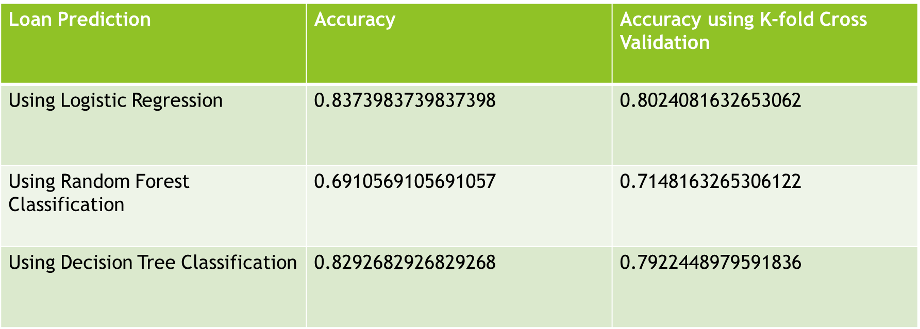
Loan prediction models comparison
This means that from the above accuracy table, we can conclude that logistic regression is best model for the loan prediction problem.

Slide 15
SYSTEM REQUIREMENTS:
HARDWARE REQUIREMENTS:
RAM: 4GB and Higher
Processor: Intel i3 and above
Hard Disk: 500GB: Minimum

Slide 16
SOFTWARE REQUIREMENTS:
OS: Windows or Linux
Python IDE : python 2.7.x and above
Setup tools and pip to be installed for 3.6 and above
Language : Python Scripting

Slide 17
CONCLUSION :
In conclusion, our customer loan prediction analysis has shown that machine learning techniques can be used to accurately predict loan repayment behavior. By analyzing historical loan data and identifying the key factors that affect loan repayment, we were able to develop a predictive model that can assess the creditworthiness of borrowers and minimize the risk of loan default. Our data exploration and visualization also provided valuable insights into the loan data, such as the importance of credit score, income, and loan amount in loan repayment. For future research, we recommend exploring additional loan features, such as employment status and payment history, and testing different machine learning algorithms to improve the accuracy of loan prediction models.

Slide 18
THANK YOU

